Slide 1

i-vengers UNITE!
We are the i-vengers from… Killamarsh Infant and Nursery School

Slide 2

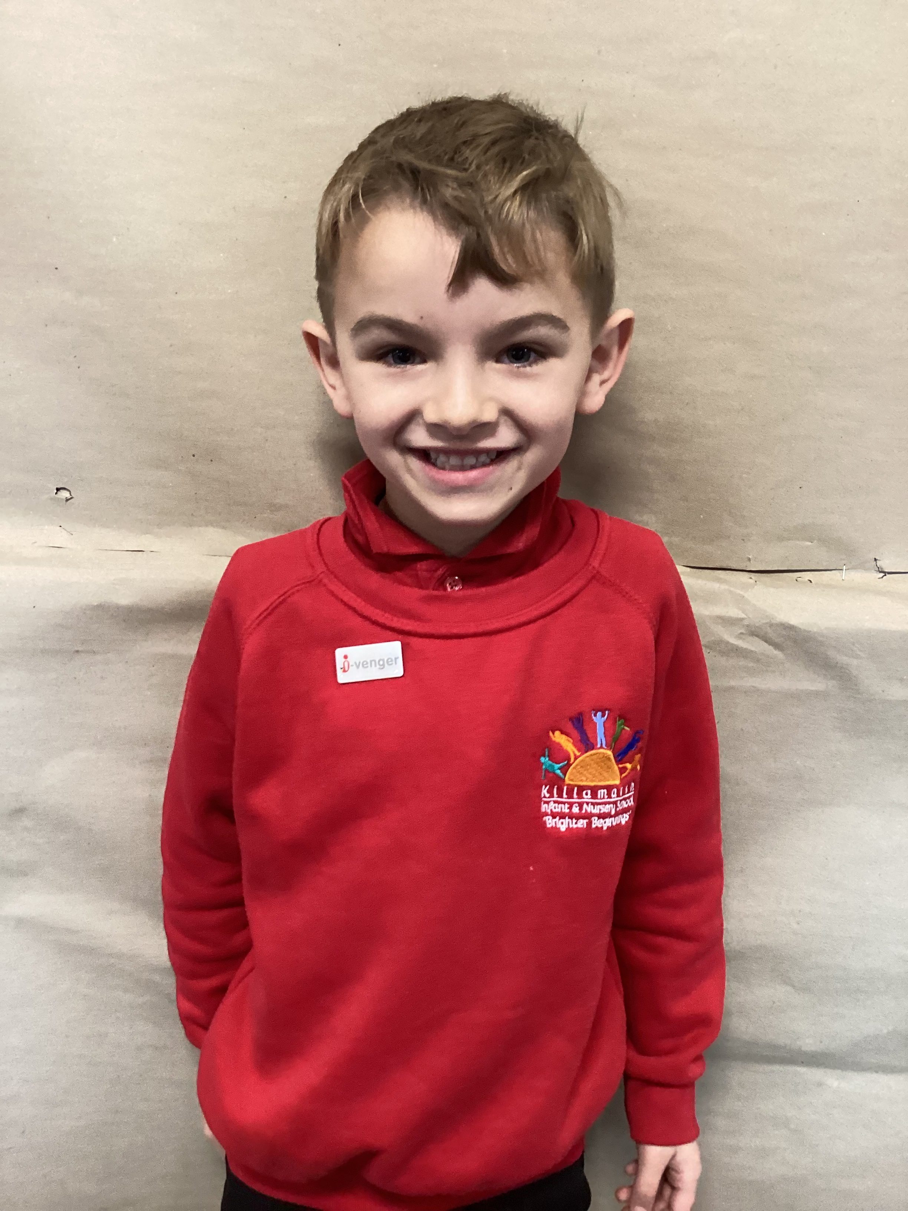
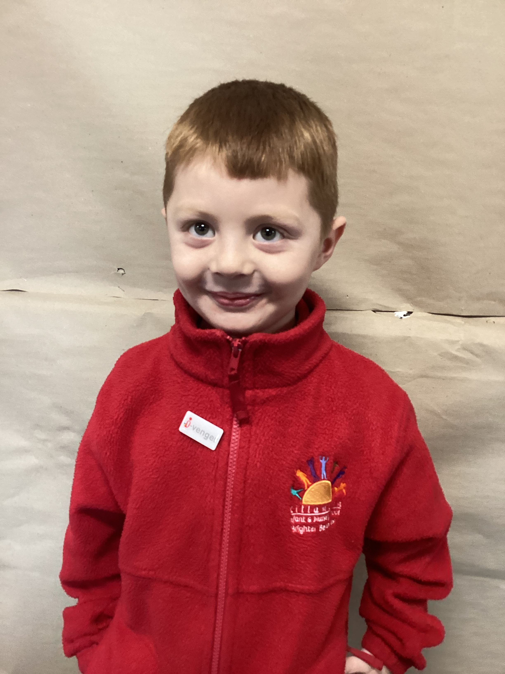
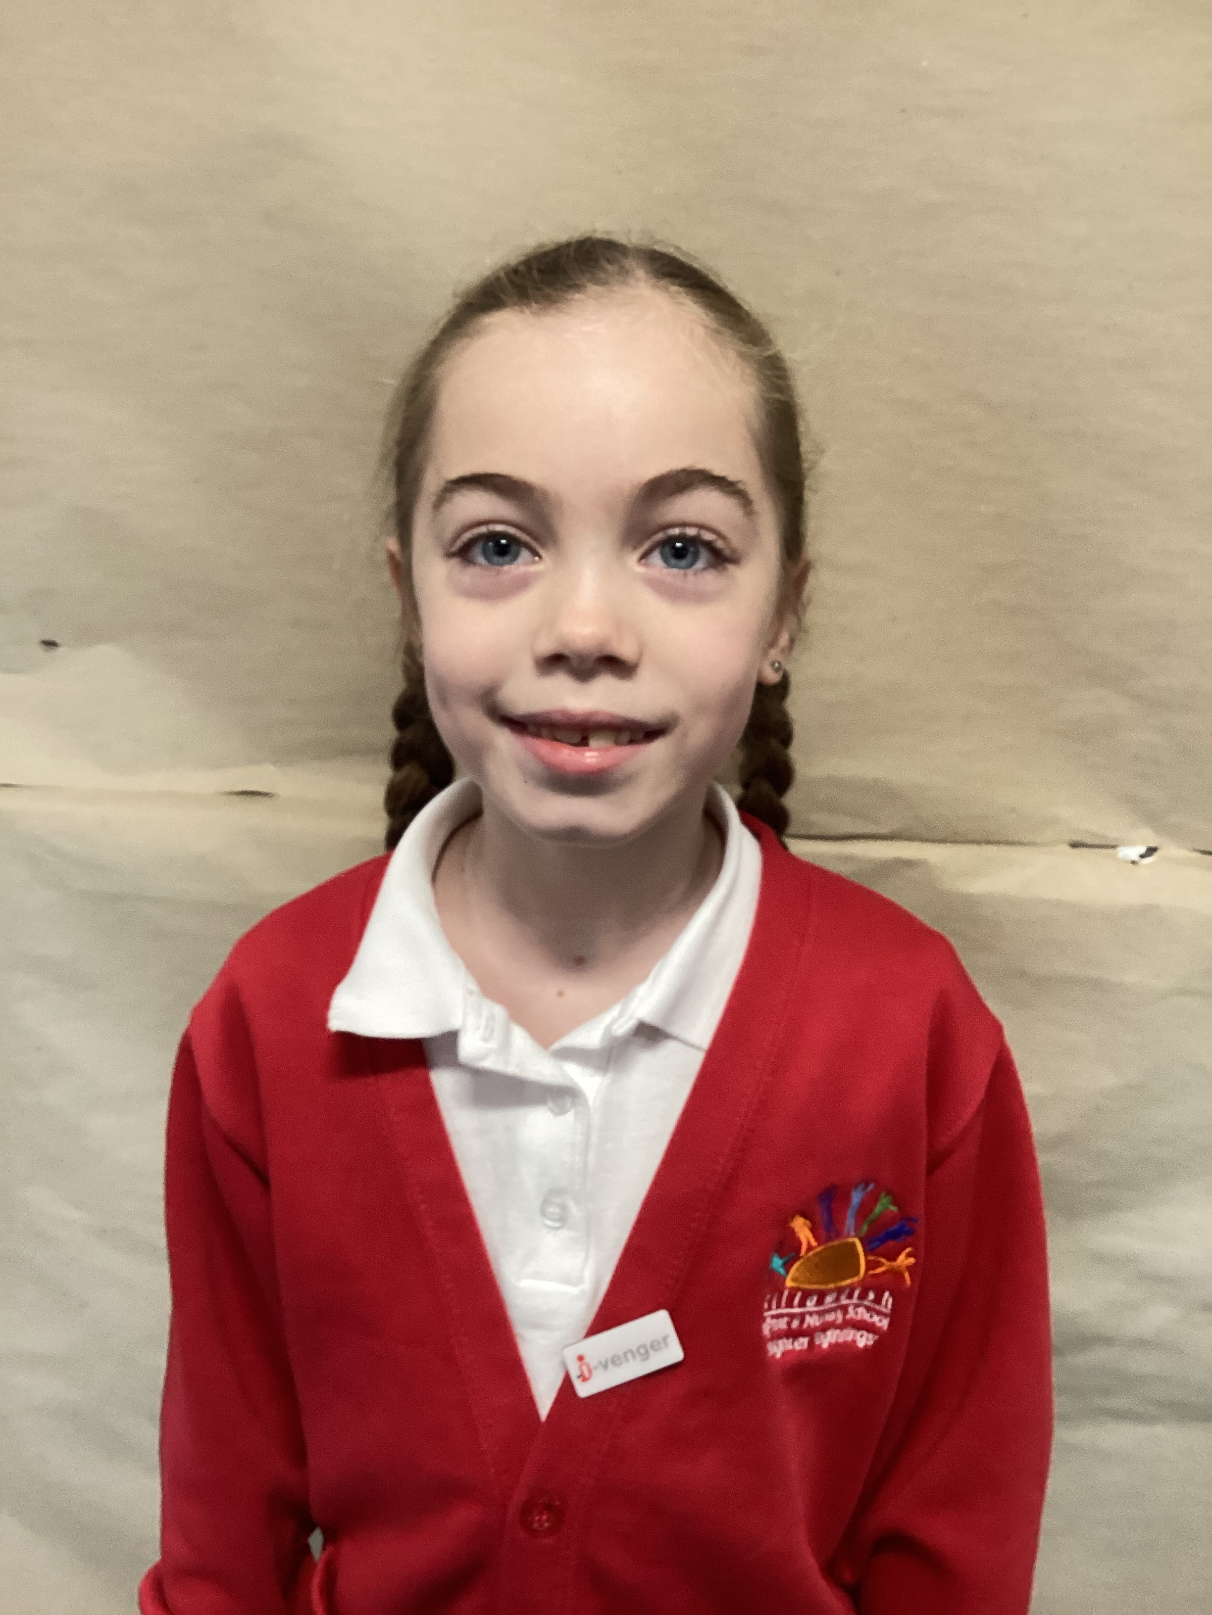
Who are we?
My name is Kaiden and my superpower is that I am very good at maths. I enjoy playing football.
My name is Bobbi and my superpower is that I am very good at science. I enjoy playing football.
My name is Aster and my superpower is that I am very good at handwriting. I enjoy doing crafts.

Slide 3
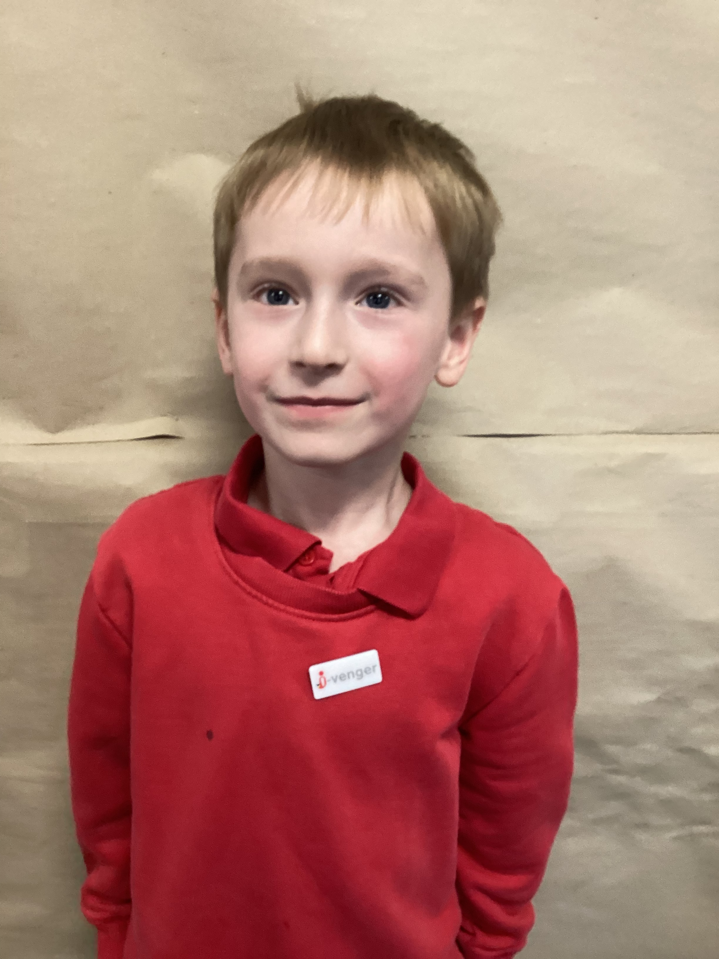
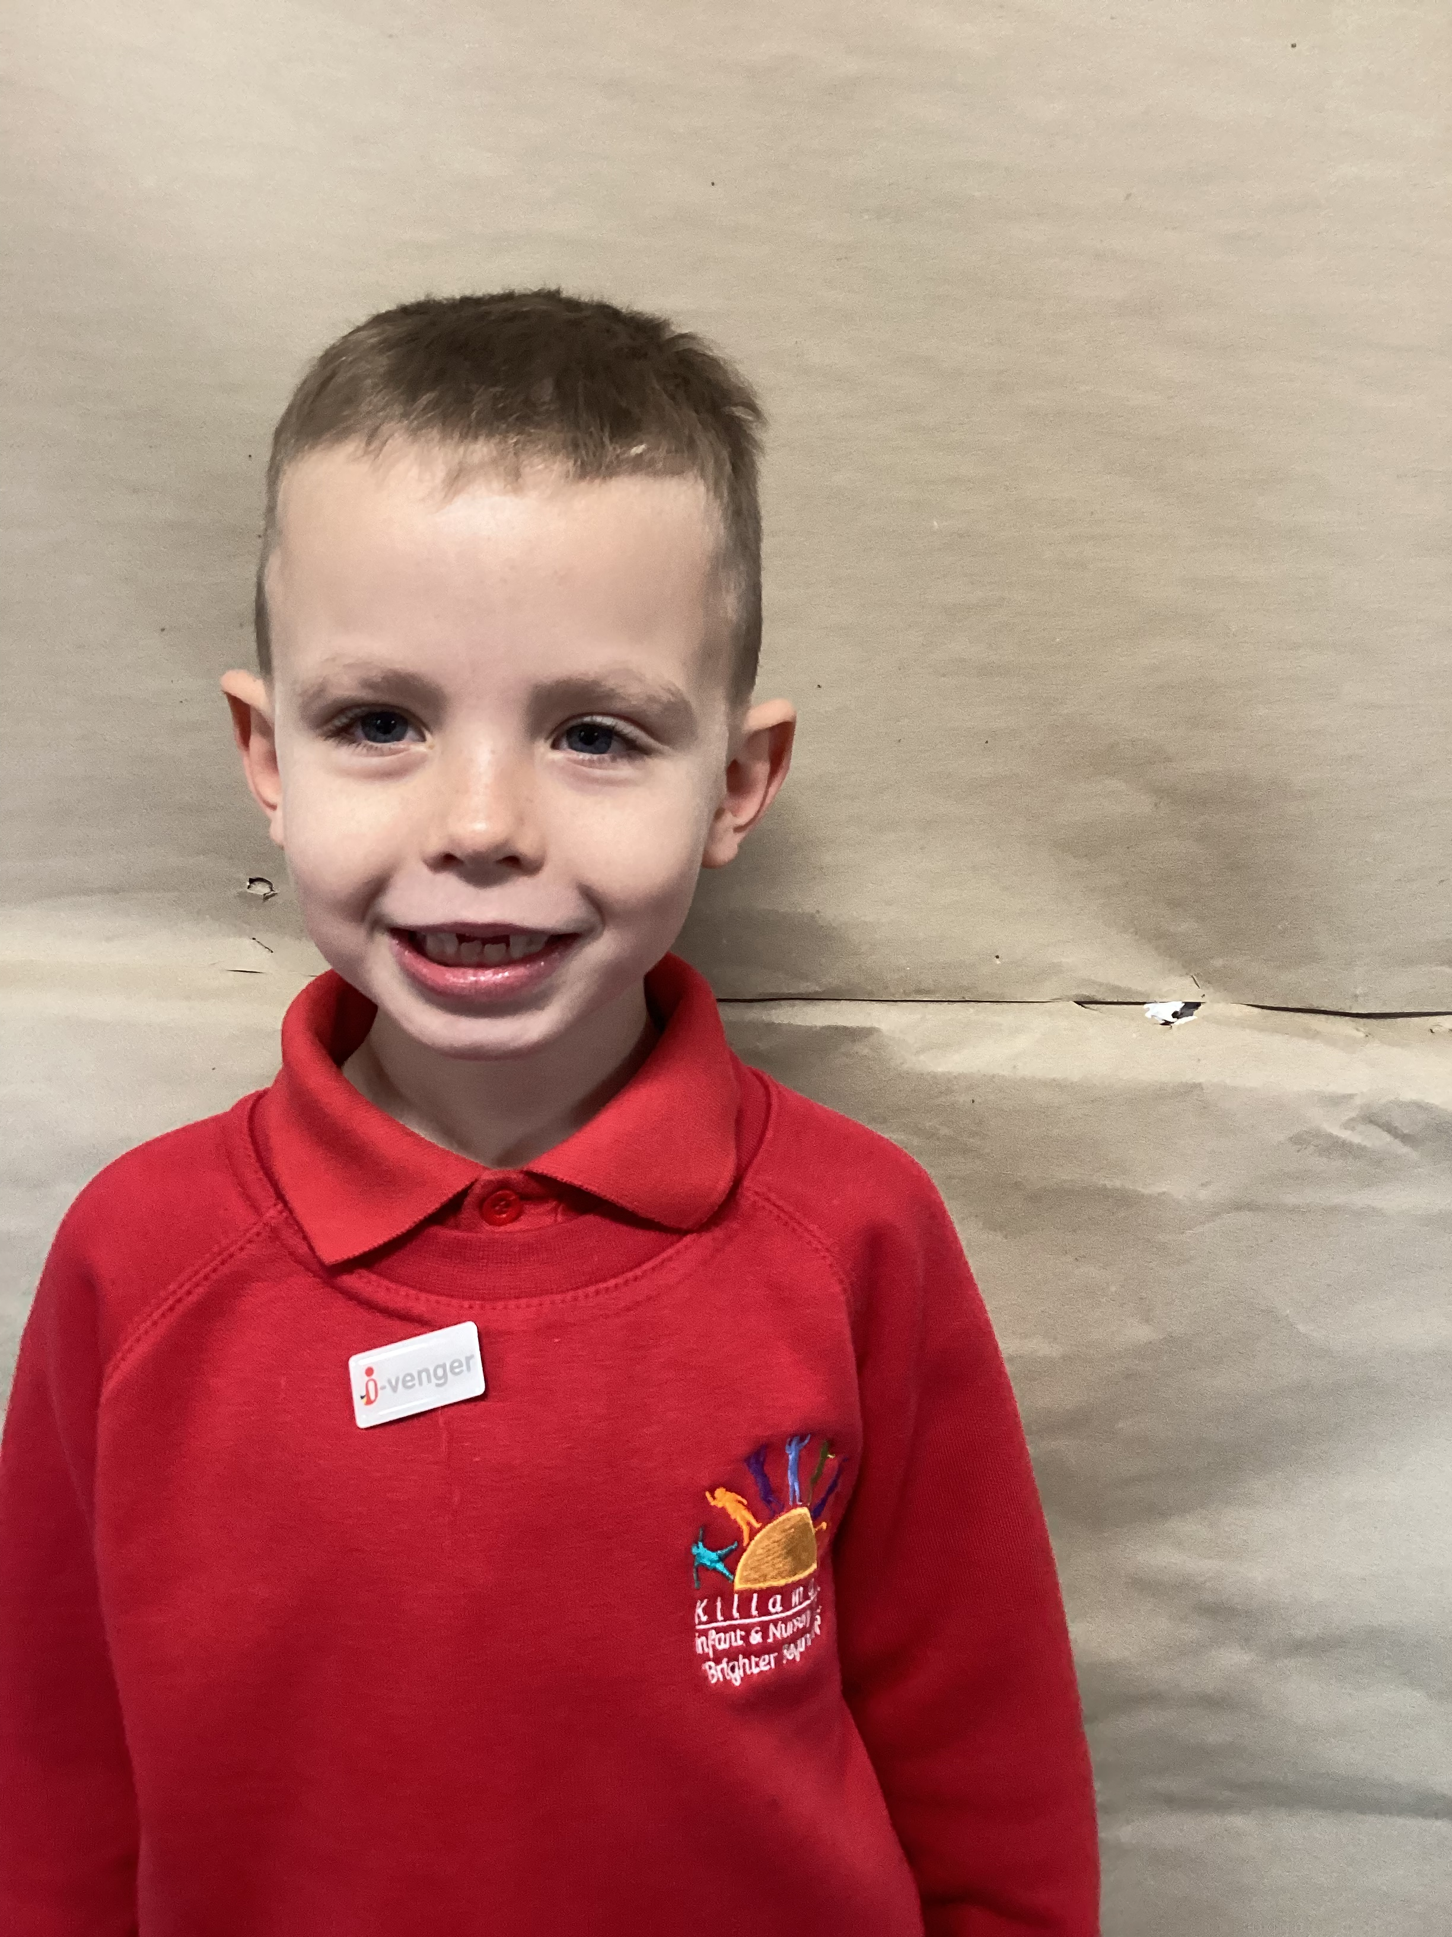
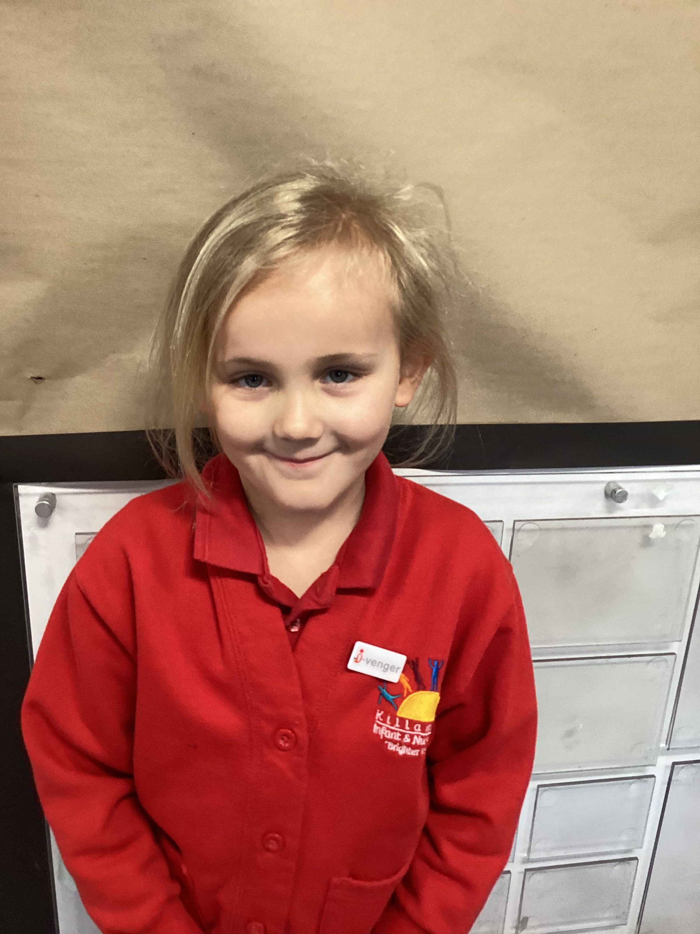
Who are we?
My name is Arthur and my superpower is that I am very good at maths. I enjoy.
My name is Montie and my superpower is that I am very good at outdoor learning. I enjoy playing football.
My name is Isla and my superpower is that I am very good at .I enjoy

Slide 4

What is an i-venger?
1. An i-venger is a digital leader.
2. We are going to help everyone else learn about online safety – including the teachers!
3. We are online heroes.
4. We will help if you don’t know much about online safety.
5. We know what to do online.

Slide 5
What we already know?
You need to keep things private.
Use passwords.
We know what is appropriate.
We need to be smart when we use computers.

Slide 6
What we are going to do next…..
The next task will enable us to take responsibility for our own privacy online. We will all take part in an activity that helps us identify, review and understand privacy controls on apps, games and social platforms. Then we will complete this activity as a whole school and also with our parents.

Slide 7


