Slide 1
I’Vengers
Sleep and Screen Time

Slide 2
Blue Light
Do you know what blue light is?
Blue light can affect how you sleep. This light comes from your tablet, your phone, your computer and even the sun.
We need some blue light but our screens give out too much.
On some screens you can change the setting to night time mode which can help.
Cutting down on screen time before bed can help your sleep.

Slide 3
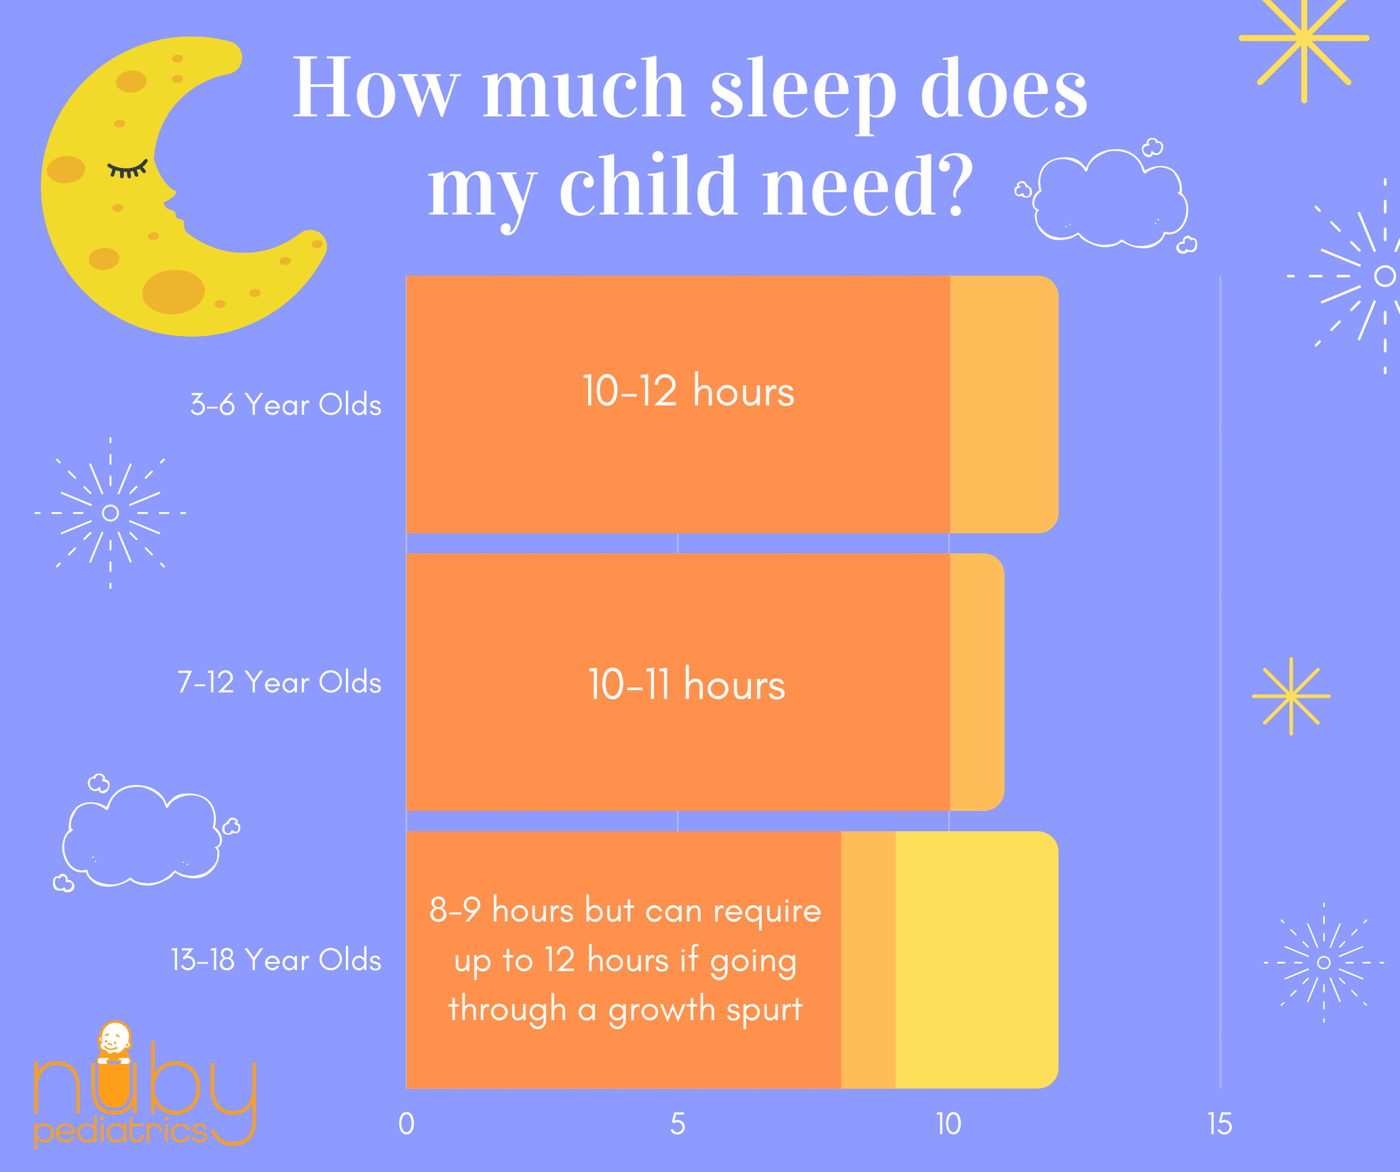
How much sleep do you need?

Slide 4
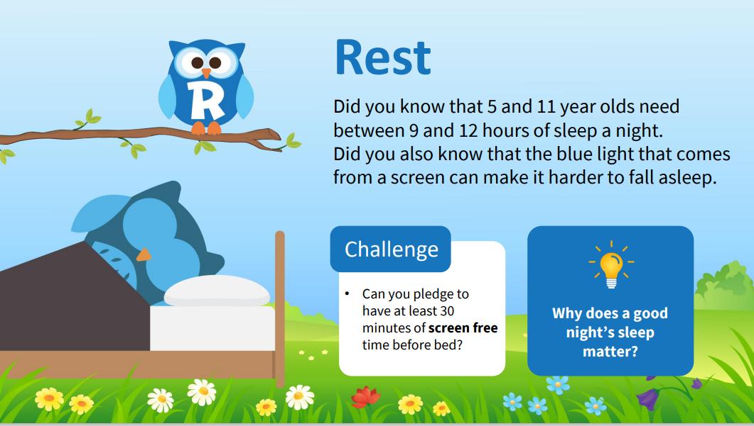
Smilers Challenge

Slide 5
What can I do instead?
Read a book or share a book with your parents.
Play a board game
Listen to calming music
Talk to your parents about your day
Draw/ colour or write
Look at the stars

Slide 6
Quiz
1. On average, how many hours of sleep does a 10-year-old need each night?
a) 9 hours 45 minutes. b) 11 hours. c) 7 hours 30 minutes.
2. A lack of sleep makes people perform better at school. True or false?
3. For most people, exercise makes sleeping easier. True or false?
4. In general, people who get a good night’s sleep feel…
a) happier b) no different c) not as happy
5. What 3 things do you think might help people get a good night’s sleep?
a) turning electronic devices off b) reading before bed c) watching TV in bed d) eating and drinking sugary foods and drinks just before bed e) keeping the room dark f) keeping the room at a comfortable temperature

Slide 7
Challenge
Make a promise to try and have 30 minutes screen free time before bed every night.
See if you sleep better on the nights you do this.
Let us know what happens.

