Slide 1

i-vengers UNITE!
We are the i-vengers from… Killamarsh Infant and Nursery School

Slide 2

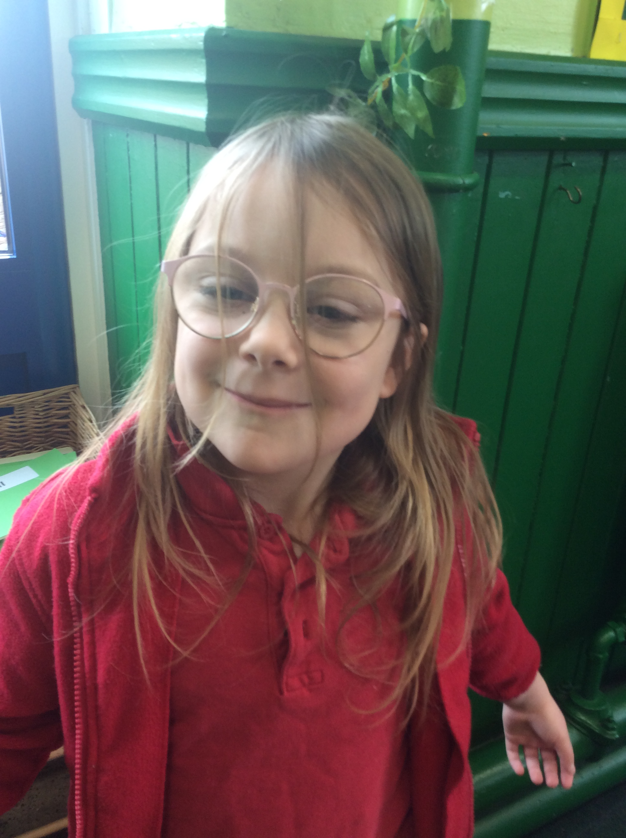
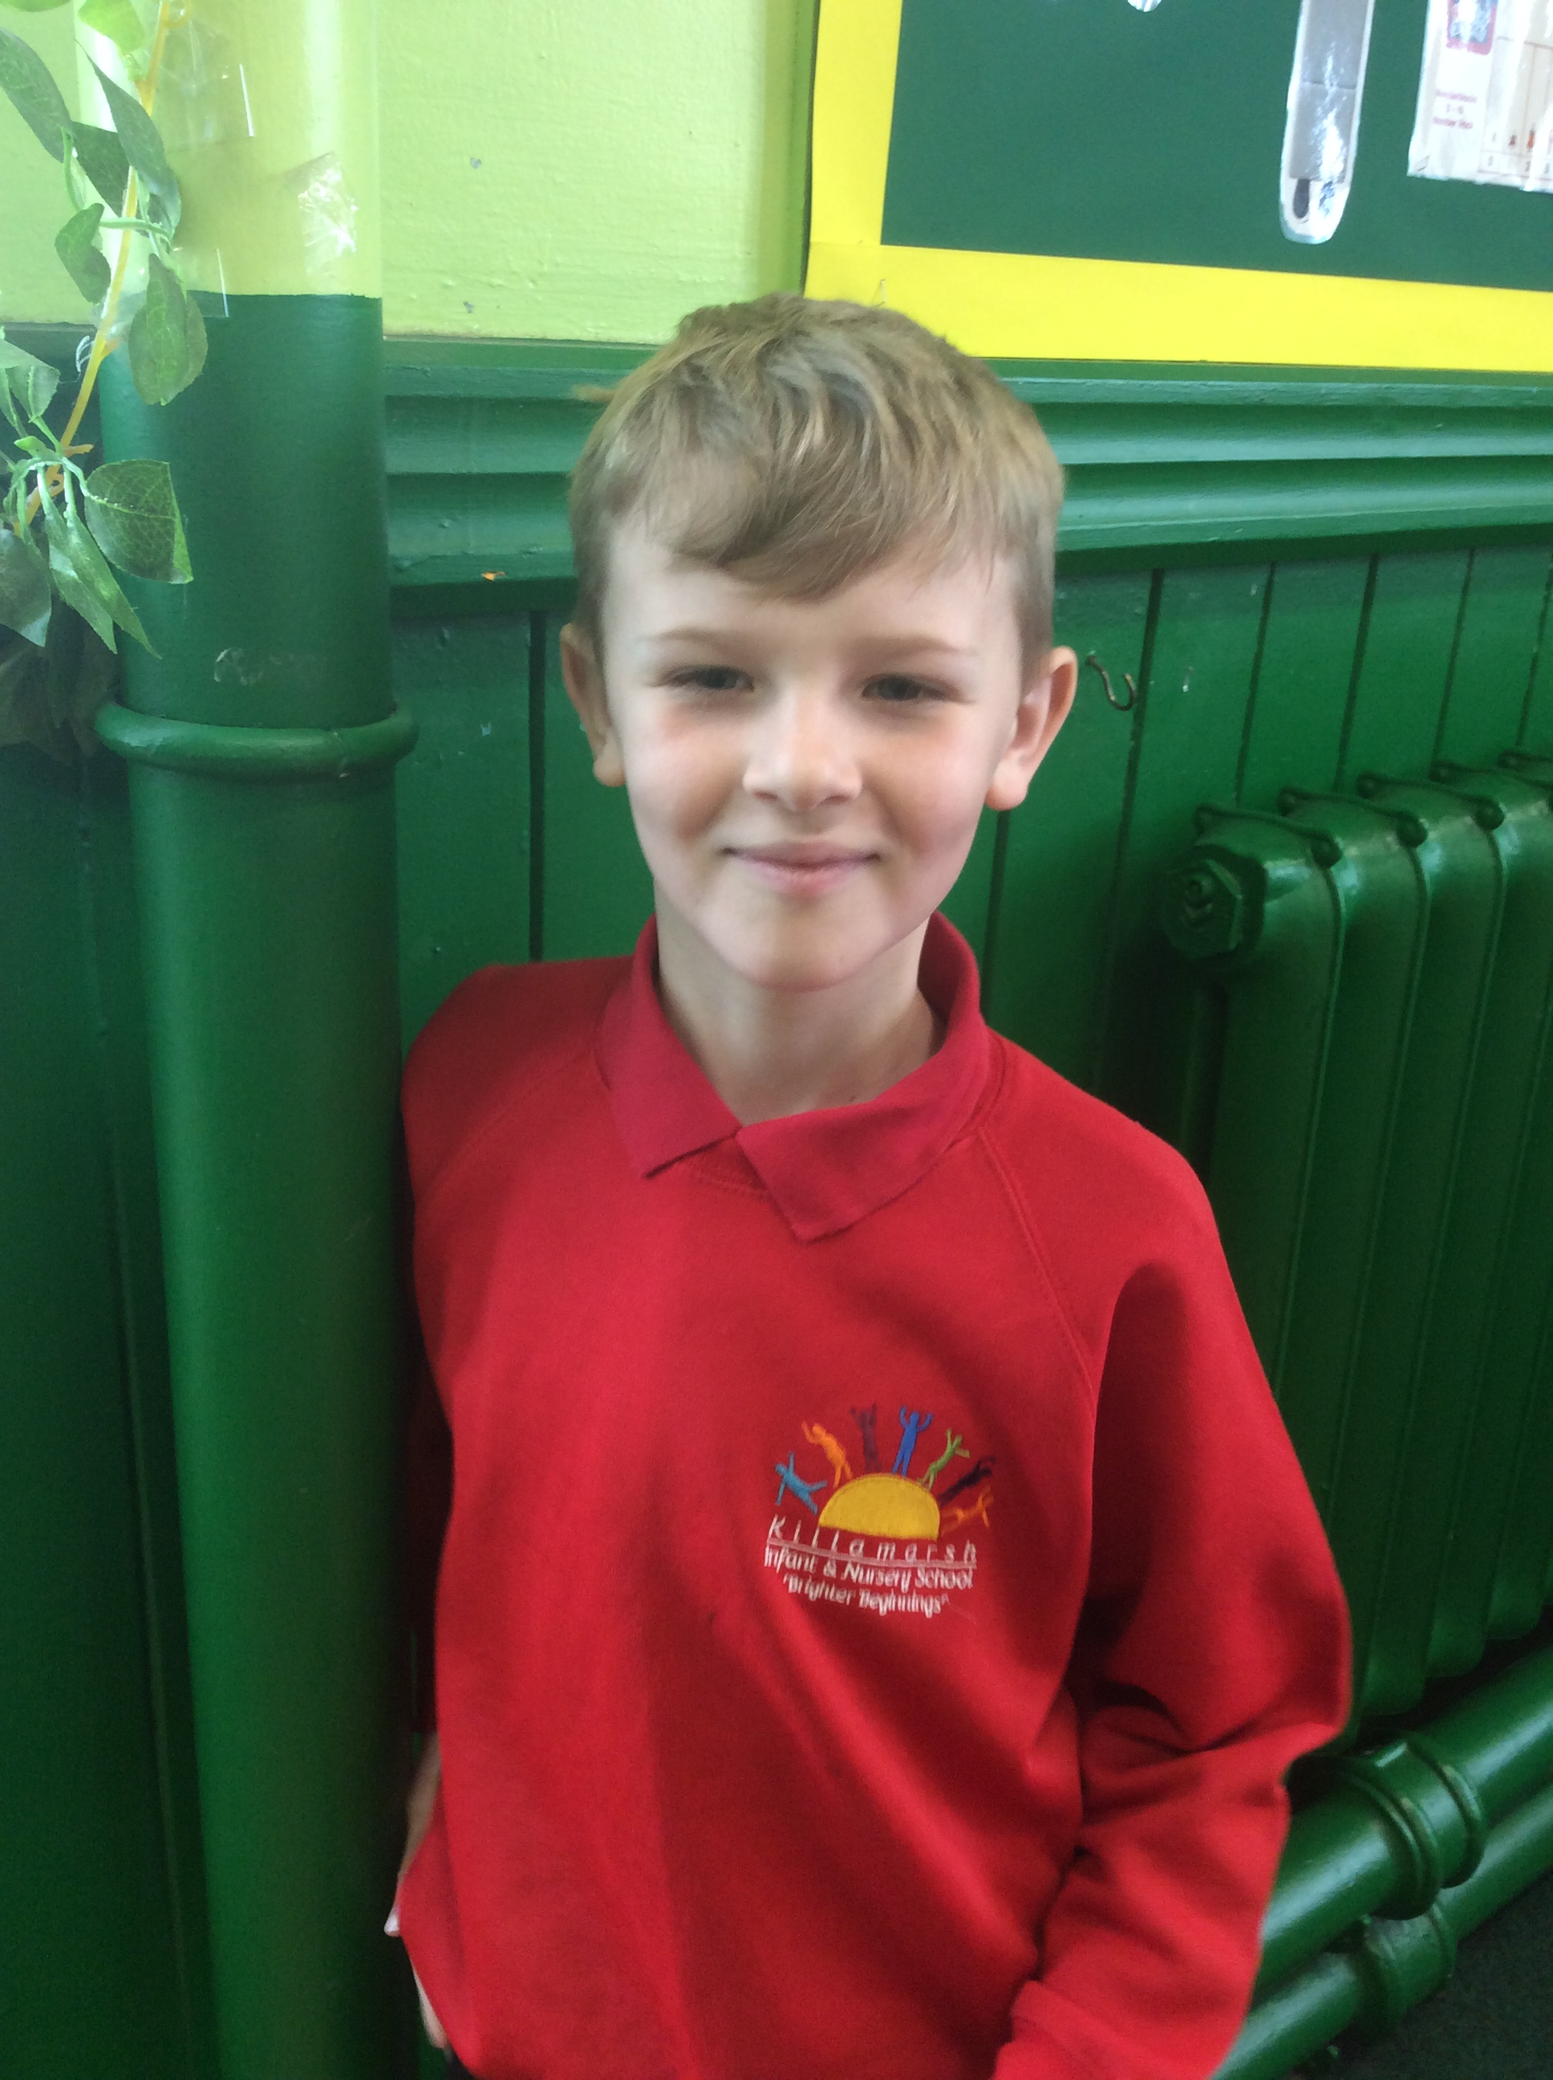
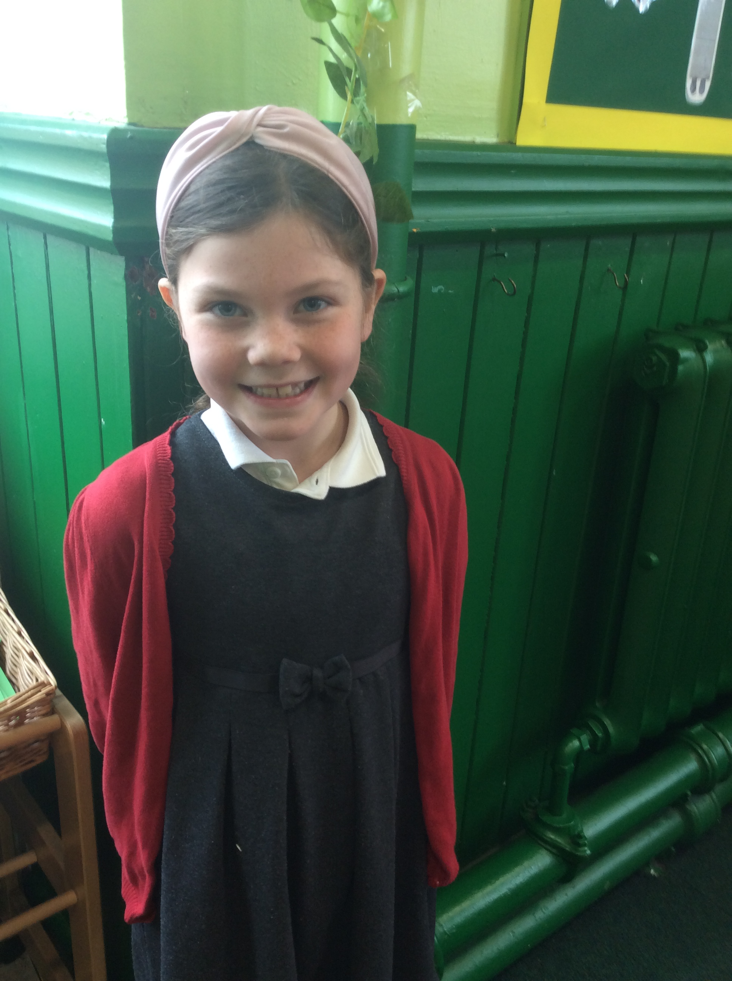
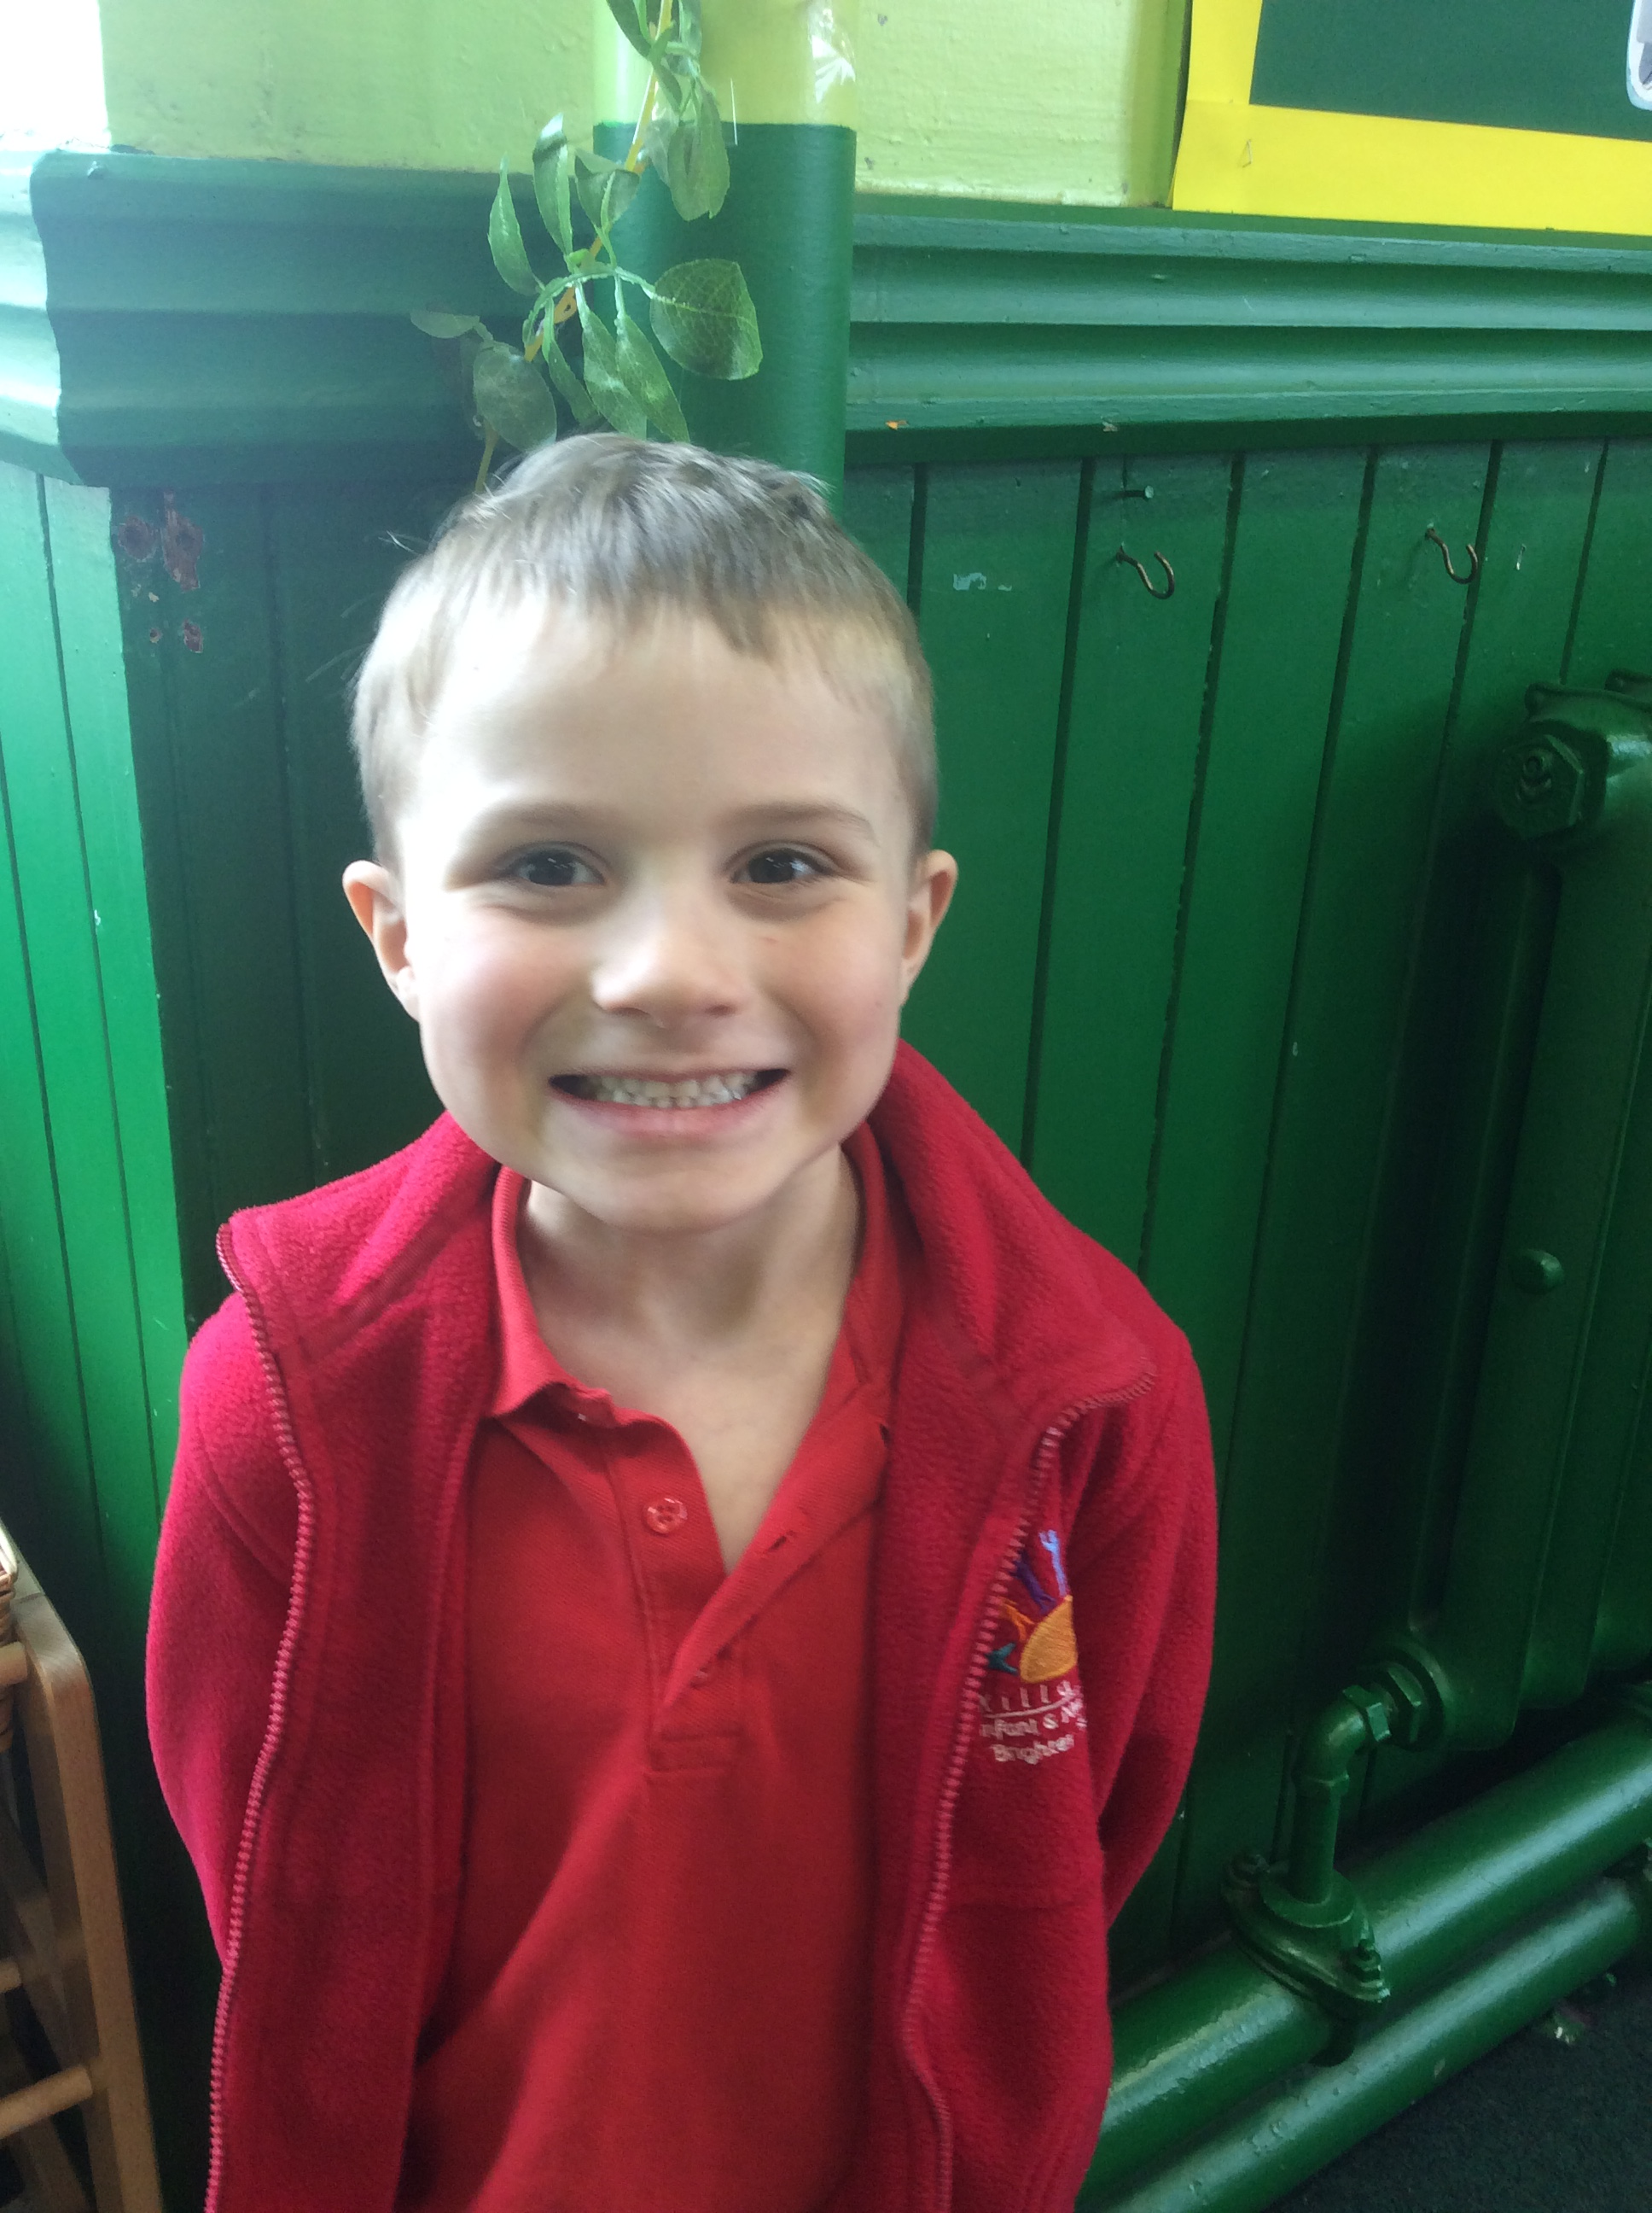
Who are we?
My name is Erin and my superpower is I am very good at maths and doing homework. I enjoy Minecraft speed runs.
My name is Cameron and my superpower is I am very good at topic. I enjoy Minecraft.
My name is Lola and my superpower is I am very good at gymnastics. I enjoy playing games like Roblox.
My name is Austen and my superpower is I sometimes do fast writing. I enjoy watching videos.

Slide 3

What is an i-venger?
1. An i-venger is a digital leader.
2. We are going to help everyone else learn about online safety – including the teachers!
3. We are online heroes.
4. We will help if you don’t know much about online safety.
5. We know what to do online.

Slide 4
What is our next task?
We are going to send out a survey to all the children and the parents.
There will be one for the children and a different one for the parents.
Please help your parents to fill these in because they will help us to complete our missions and get our first certificate.

Slide 5


