Slide 1
I’Vengers
Sleep and Screen Time

Slide 2
Blue Light
Do you know what blue light is?
Blue light can affect how you sleep. This light comes from your tablet, your phone, your computer and even the sun.
We need some blue light but our screens give out too much.
On some screens you can change the setting to night time mode which can help.
Cutting down on screen time before bed can help your sleep.

Slide 3
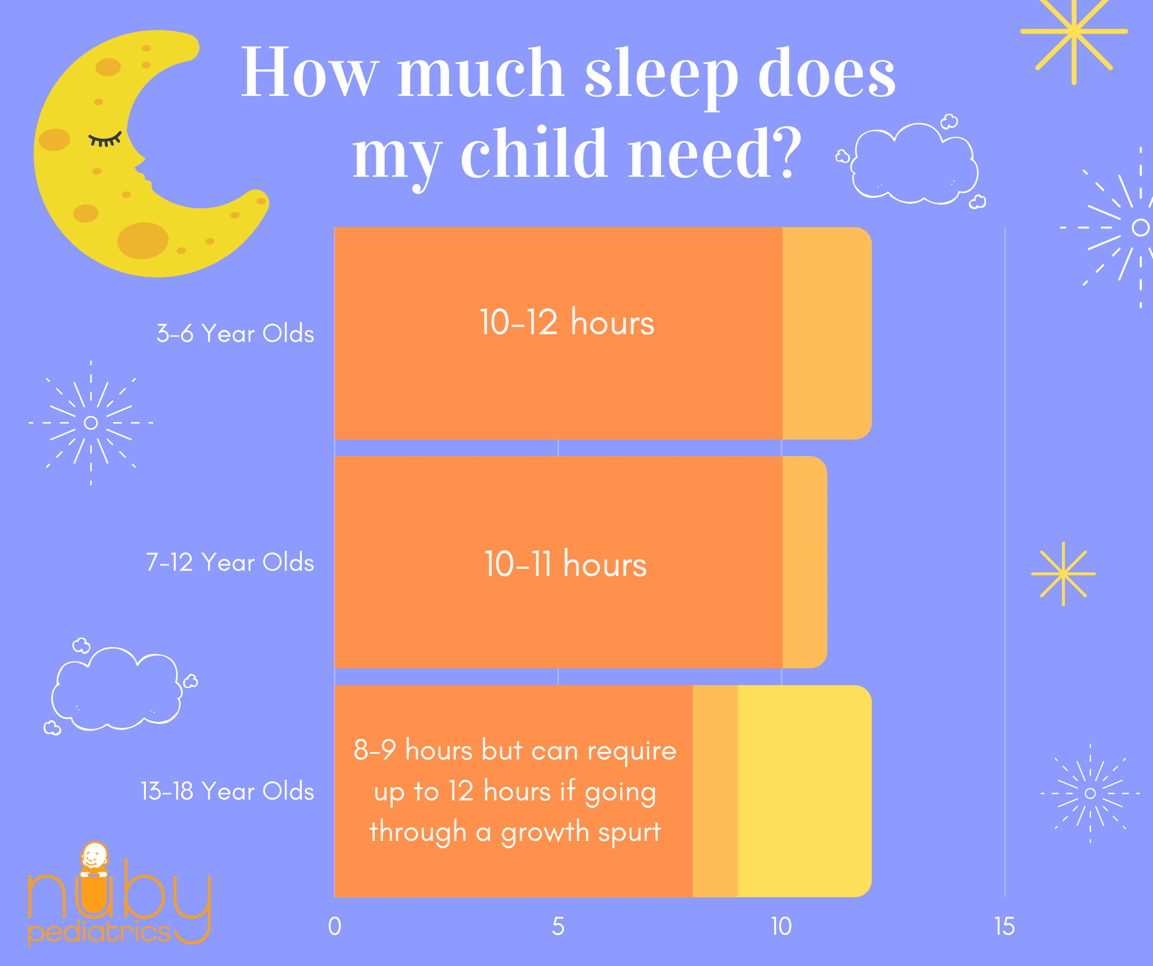
How much sleep do you need?

Slide 4
What can I do instead?
Read a book or share a book with your parents.
Play a board game
Listen to calming music
Talk to your parents about your day
Draw/ colour or write
Play with puppets
Play outside

Slide 5
Why do we need sleep?
It helps our brains to rest.
It helps our bodies remain healthy.
We need it for our brains to function properly.
It helps us to concentrate.

Slide 6
Quiz
1. On average, how many hours of sleep does a 6 or 7-year-old need each night?
2. A lack of sleep makes people perform better at school. True or false?
3. Why do we need sleep?
4. Why do we need to stay off electronics before bed?

Slide 7
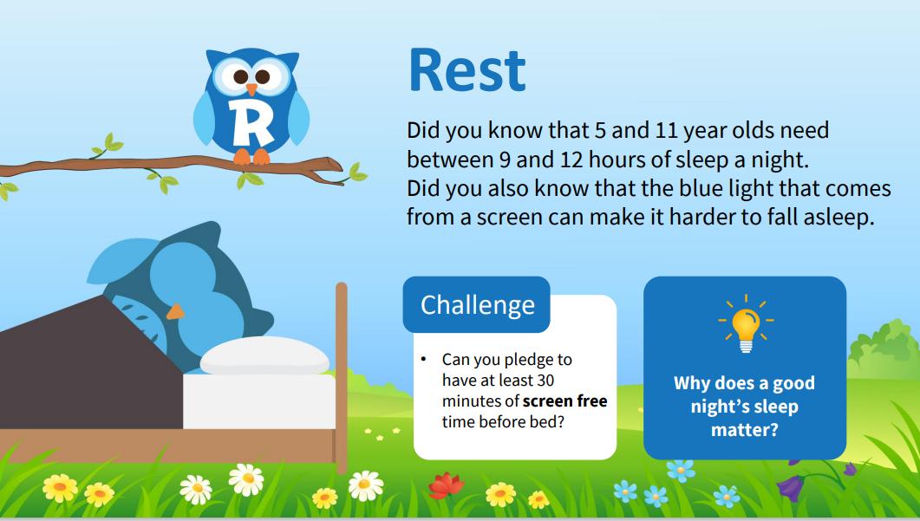
Smilers Challenge

Slide 8
Challenge
Make a promise to try and have 30 minutes screen free time before bed every night.
See if you sleep better on the nights you do this.
Let us know what happens.

